Slide 1


Slide 2
PROBLEM SOLVING & PROGRAMMING II
ARRAYS & VECTORS

Slide 3
arrays

Slide 4
Objectives
ARRAYS: Students should be able to:
implement arrays containing different variable types
iterate through arrays to evaluate and/or manipulate members
utilize arrays in functions
Implement and utilize two dimensional arrays

Slide 5
Arrays
Ordered set of items of a given data type
Each item is called an element
Index starts at 0
Standard arrays are static in C++ and cannot be resized.
Not memory safe

Slide 6

Arrays
Example 1
note: bracket
Create an array
datatype variable[size];
datatype variable[size] = {v1, v1, … };
Set a value
variable[index] = value;
Get a value
my_var = variable[index]
note: braces
Note: Array values are not initialized
int dailySalesA[7];
int dailySalesB[7] = {0, 500, 200, 300, 800, 1000, 0};
index is of integer type
dailySalesB[0] = 50;
dailySalesB[1] = 100;
0 | 500 | 200 | 300 | 800 | 1000 | 0
50 | 100 | 200 | 300 | 800 | 1000 | 0
0 | 1 | 2 | 3 | 4 | 5 | 6

Slide 7
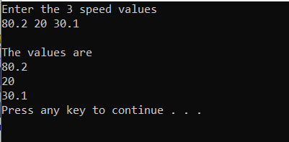
Example 2
You cannot
allocate space for an array using a variable
ONLY a
const
Can be used!
const int ARRAY_SIZE = 3;
double speeds[ARRAY _SIZE];
cout << "Enter the 3 speed values" << endl;
cin >> speeds[0] >> speeds[1] >> speeds[2];
cout << endl << "The values are " << endl;
cout << speeds[0] << endl;
cout << speeds[1] << endl;
cout << speeds[2] << endl;

Slide 8
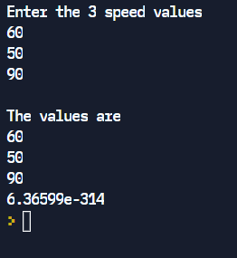
Example 2
const int SPEED_SIZE = 3;
double speeds[SPEED_SIZE];
cout << "Enter the 3 speed values" << endl;
cin >> speeds[0] >> speeds[1] >> speeds[2];
cout << endl << "The values are " << endl;
cout << speeds[0] << endl;
cout << speeds[1] << endl;
cout << speeds[2] << endl;
cout << speeds[3] << endl;
arrays are
NOT
safe!!
(out of range)

Slide 9
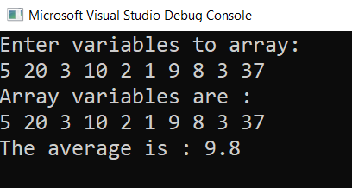
ARRAYS IN FUNCTIONS
Example 3
// Returns the average of array variables
void input(int a[], int size);
void show(int a[], int size);
double average(int a[], int size);
int main()
{
const int number = 10;
int age[number];
input(age, number);
show(age, number);
double avg = average(age, number);
cout << "The average is : “ << avg << endl;
return 0;
}
void input(int a[], int size)
{
cout << "Enter variables to array:\n";
for (int i = 0; i < size; i++)
{
cin >> a[i];
}
}
void show(int a[], int size)
{
cout << "Array variables are : \n";
for (int i = 0; i < size; i++)
{
cout << a[i] << " ";
}
cout << "\n";
}
double average(int a[], int size)
{
double total = 0;
double avg;
for (int i = 0; i < size; i++)
{
total += a[i];
}
avg = (total / size);
return avg;
}
Notes:
NOTES: in functions – a pointer to the array is passed (a copy is not made) ----
so functions CAN change the value of the array
to prevent this – use const
use [] to indicate you are passing an array
need to pass the size of the array as well

Slide 10
Swap first & last
ARRAYS IN FUNCTIONS
Example 4

Slide 11
vectors

Slide 12
objectives
VECTORS: Students will be able to
implement vectors containing different variable types
iterate through vectors to evaluate and/or manipulate members using various vector methods (functions)
utilize vectors in functions
implement and utilize two dimensional vectors
explain the major differences between an array and a vector

Slide 13
vectors
container class in c++
Like arrays:
Ordered set of items of a given data type
Each item is called an element
Index starts at 0
Unline arrays:
Passed by value (NOT by reference as arrays are)
Can be resized
Memory safe (can not access out of range indexes)
Common functions available include:
Add elements to the end: vector.push_back(element)
Return an element at a position: vector.at(index)
Get the size of the vector: vector.size()
Remove all elements: vector.clear()
Insert before a position: vector.insertpos, element)

Slide 14
Vectors
vectors
Include vector
#include <vector>
Create a vector
vector<datatype> vectorName(size);
vector<datatype> vectorName = {v1, v2, … }
Assign a value
vectorName.at(index) = value;
Return a value
my_var = vectorName.at(index);
Get size of vector
size = vectorName.size();
Notes:
NOTE: elements are initialized to 0s when declared
vector<int> thisVector (7, 100) will init a vector of size 7 to 100

Slide 15
Example 1
vectors
vector<int> ages;
int age, number = 1;
cout << "Enter an age for person # " << number++ << " : ";
cin >> age;
while (age > 0) {
ages.push_back(age);
cout << "Enter an age for person # " << number++ << " : ";
cin >> age;
}
cout << "The ages entered were" << endl;
for (int i = 0; i < ages.size(); i++)
cout << "P:" << i+1 << "\t Age:" << ages.at(i) << endl;
}
Notes:
What’s with number++

Slide 16
Example 2
vectors
vector<int> ages;
int age, number = 1;
cout << "Enter an age for person # " << number++ << " : ";
cin >> age;
while (age > 0) {
ages.push_back(age);
cout << "Enter an age for person # " << number++ << " : ";
cin >> age;
}
cout << "The ages entered were" << endl;
for (int i = 0; i < ages.size(); i++)
cout << "P:" << i+1 << "\t Age:" << ages.at(i) << endl;
}
ages.assign(5, 99);
ages.insert(ages.begin()+2, 77);
Notes:
What’s with number++

Slide 17
Multi-Dimensional vectors
#include <iostream>
#include <vector>
#include <iomanip>
using namespace std;
Example 3
void loadTable(vector<vector<int>> &t, int &rSize, int &cSize);
// inputs a point to an empty vector
// load the vector with values
void printTable(vector<vector<int>> t, int rSize, int cSize);
// inputs a copy vector and dimension
// prints the 2-d vector
int main() {
int vSize;
cout << "Enter dimension of the multiplication table: ";
cin >> vSize;
vector<vector<int>> table;
loadTable (table, vSize);
printTable (table, vSize);
}

Slide 18
Multi-Dimensional vector multiplication tables
void loadTable(vector<vector<int>> &t, int rSize, int cSize){
vector<int> temp;
for (int i = 0; i < vSize; i++){
t.push_back(temp);
for (int j = 0; j < vSize; j++){
t[i].push_back(i*j);
}
}
}
void printTable(vector<vector<int>> t, int vSize){
for (int i = 0; i < vSize; i++){
for (int j = 0; j < vSize; j++){
cout << setw(5) << t.at(i).at(j);
}
cout << endl;
}
}

Slide 19
Arrays more detail
ARRAYS

Slide 20
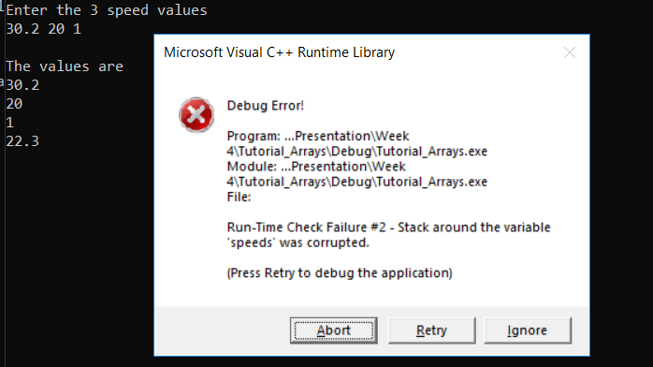
Example
const int SPEED_SIZE = 3;
double speeds[SPEED_SIZE];
cout << "Enter the 3 speed values" << endl;
cin >> speeds[0] >> speeds[1] >> speeds[2];
speeds[3] = 22.3;
cout << endl << "The values are " << endl;
cout << speeds[0] << endl;
cout << speeds[1] << endl;
cout << speeds[2] << endl;
cout << speeds[3] << endl;

Slide 21
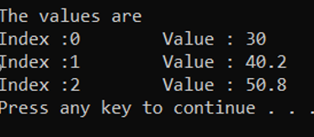
Iterate Over Arrays
const int SPEED_SIZE = 3;
double speeds[SPEED_SIZE] = { 30.0, 40.2, 50.8 };
cout << endl << "The values are " << endl;
for (int index = 0; index < SPEED_SIZE; index++)
{
cout << "Index :" << index << "\t";
cout << "Value : " << speeds[index] << endl;
}
for (int i : speeds)
cout << i << " ";

Slide 22
Functions & Arrays
send array & size
#include <iostream>
using namespace std;
int main() {
int sizeArr;
cout << “Enter Array Size: ";
cin >> sizeArr;
int arr1[sizeArr];
setArr(arr1, sizeArr);
printArr(arr1, sizeArr);
}
void setArr(int arr1[], int sizeArr){
cout << “Enter Array values: ";
for (int i = 0; i < sizeArr; i++)
cin >> arr1[i];
}
void printArr(int arr1[], int sizeArr){
for (int i = 0; i < sizeArr; i++)
cout << arr1[i]<< " " ;
cout << endl;
}

Slide 23
Ex 5: MULTI- DIMENSIONAL ARRAYS
Syntax:
Type Array_Name[size_1][size_2]…..[size_last];
int matrix[5][10];
double cube[10][10][10];
char page[30][50];
When multidimensional array is given in a function heading or declaration, the size of the first dimension is not given , but the remaining dimension sizes must be given in square brackets.
char page[][50];
int matrix[][10];
void show(int matrix[][10], int size_dim1);
When calling a function:
show(matrix1, dim1)

Slide 24
FILL 2D ARRAY Find min value
Ex 5: MULTI- DIMENSIONAL ARRAYS
Create a function to read in a 2-D array
Create a function to find the minimum value in the array
FUNCTION DECLARTION:
fillArray( int arr1[][4], int sizeDim1, int sizeDim2);
minArray(int arr1[][4], int sizeDim1, int sizeDim2);
https://bit.ly/CS201Fun4

Slide 25
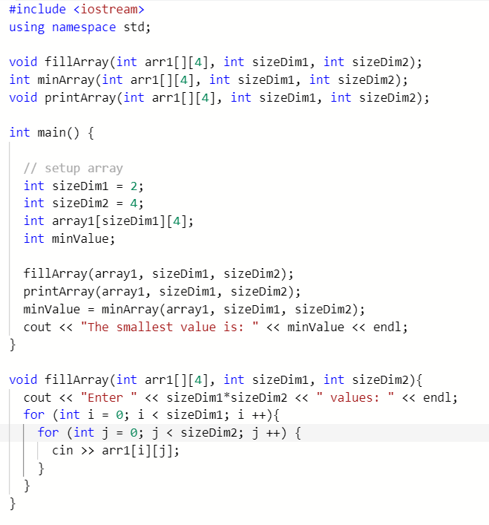
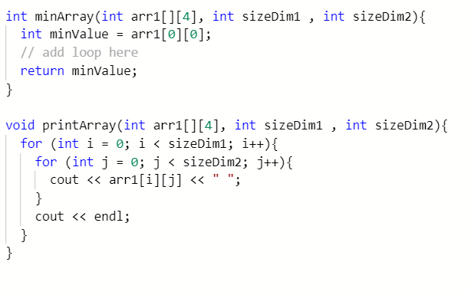
FILL 2D ARRAY Find min value
Add find max

Slide 26

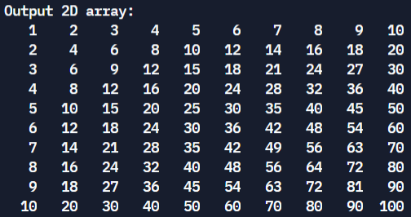
Multiplication tables

Slide 27
Multiplication tables
void main()
int a[10][10];
cout << "Fill two Dimension array:\n";
for (int i = 0; i < 10; i++){
for (int j = 0; j < 10; j++) {
a[i][j] = (i+1) * (j+1);
}
}
cout << "Output 2D array: \n";
for (int i = 0; i < 10; i++) {
for (int j = 0; j < 10; j++) {
cout << setw(4)<< a[i][j] << " ";
}
cout << endl;
}

Slide 28
Vectors more details

Slide 29
Vectors operations ( more )
EXAMPLES
vector.resize(n, value); | Void resize(int n, int value); n is the new container size. new elements are initialized with value
vector.push_back(value); | void push_back(value); adds new element value will resize if needed.
outVal = vector.back(); | int back(); returns vector's last element. vector is unchanged
vector.pop_back(); | void pop_back(); Removes the last element.
Notes:
push_back() This effectively increases the container size by one, which causes an automatic reallocation of the allocated storage space if -and only if- the new vector size surpasses the current vector capacity.

Slide 30
Vectors operations ( more )
EXAMPLES
vector.assign(n, value); | assigns value to the first n elements will remove additional elements in the vector
vector.insert(position,value); | adds element value in front of position given. will resize if needed position is an iterator
vector<elementType>::iterator it; it = vector.begin(); | sets the iterator to the beginning of vector
vector.erase(); | removes elements from the vector (can remove a range)
Notes:
push_back() This effectively increases the container size by one, which causes an automatic reallocation of the allocated storage space if -and only if- the new vector size surpasses the current vector capacity.

Slide 31
Vectors operations ( more )
EXAMPLES
vector.clear(); | removes all elements in the vector
vector.insert(position,value); | adds element value in front of position given. will resize if needed position is an iterator
vector<elementType>::iterator it; it = vector.begin(); | sets the iterator to the beginning of vector
vector.erase(); | removes elements from the vector (can remove a range)
Notes:
push_back() This effectively increases the container size by one, which causes an automatic reallocation of the allocated storage space if -and only if- the new vector size surpasses the current vector capacity.

Slide 32
empty() – Returns whether the container is empty. begin() – Returns an iterator pointing to the first element in the vector end() – Returns an iterator pointing to the theoretical element that follows the last element in the vector size() – Returns the number of elements in the vector. resize(n) – Resizes the container so that it contains ‘n’ elements. swap() – It is used to swap the contents of one vector with another vector of same type. Sizes may differ.
Vectors operations ( more )
Notes:
push_back() This effectively increases the container size by one, which causes an automatic reallocation of the allocated storage space if -and only if- the new vector size surpasses the current vector capacity.

Slide 33
Vector resize (6.12.1)
NOTE:
create a vector of size 4
input the vector size
resize the vector based on input
print the current size
include <iostream>
#include <vector>
using namespace std;
int main() {
vector<int> sensorReadings(4);
int currentSize;
int input;
cin >> input;
sensorReadings.resize(input);
currentSize = sensorReadings.size();
cout << "Number of elements: " << currentSize << endl;
return 0;
}

Slide 34
Copying & Comparing vectors
vector <int> myList1 = {1,2,3};
vector <int> myList2 = {3, 4, 5, 6, 7};
vector <int> myList3 = {7, 8, 9};
vector <int> myList4 = {7, 8, 9};
myList3 == myList4 is true (contents are the same)
myList1 == myList3 is NOT true
myList2 = myList1 will set myList2 = {1,2,3}
Notes:
What’s with number++

Slide 35
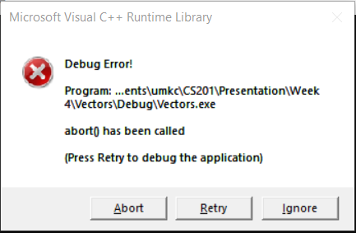
Accessing Invalid Index
vector<int> ages = { 3, 50 };
cout << ages.at(3);

Slide 36
Vectors & l0oping (6.12.2)
#include <iostream>
#include <vector>
using namespace std;
int main() {
vector<int> countDown(0);
int newSize;
unsigned int i;
cin >> newSize;
/* Your solution goes here */
countDown.resize(newSize);
int val = newSize;
for (i = 0; i < newSize; ++i) {
countDown.at(i) = val;
val --;
}
for (i = 0; i < countDown.size(); ++i) {
cout << countDown.at(i) << " ";
}
cout << "Go!" << endl;
return 0;
}

Slide 37
Multi-Dimensional Vectors
const int NUM_ROWS = 4;
const int NUM_COLS = 2;
vector<vector<int>> ages;
ages.resize(NUM_ROWS);
ages.at(0).resize(NUM_COLS);
ages.at(1).resize(NUM_COLS);
//Populate row # 0
ages.at(0).at(0) = 3;
ages.at(0).at(1) = 5;
Use vector.resize to
to set # rows
then resize each row to the # of cols
(not all rows need to have the same number of columns!)

Slide 38
Vectors algorithms

Slide 39
Algorithm 1 – 2-D fill vector, print, find min & max Functions

Slide 40
Algorithm 2 – Adding matrices

Slide 41
ALGORITHM 3
Write the code for sorting a vector

Slide 42
ALGORITHM 3 – sortArray
INPUT: 2 values
OUTPUT: swap 2 values
swap(a,b):
SET temp = a
a = b
b = temp
PRE: an array & array size are sent
POST: array is sorted in ascending order
sortArray(array, arraySize):
FOR i=1 to arraySize {
SET j = i
WHILE (j > 0 and arr[j] < arr[j-1])
swap arr[j] and arr[j-1]
j = j – 1
ENDWHILE
ENDFOR

Slide 43
ALGORITHM 3 – sortArray
PRE: an array & array size are sent
POST: array is sorted in ascending order
sortArray(array, arraySize):
FOR i=1 to arraySize {
SET j = i
WHILE (j > 0 and arr[j] < arr[j-1])
swap arr[j] and arr[j-1]
j = j – 1
ENDWHILE
ENDFOR
Line | array | arraySize | i | j
1 | 15,7,3,4,9,5 | 6
2(F)

Slide 44
ALGORITHM 3 – sortArray
PRE: an array & array size are sent
POST: array is sorted in ascending order
sortArray(array, arraySize):
FOR i=1 to arraySize {
SET j = i
WHILE (j > 0 and arr[j] < arr[j-1])
swap arr[j] and arr[j-1]
j = j – 1
ENDWHILE
ENDFOR
Line | array | arraySize | i | j
1 | 15,7,3,4,9,5 | 6
2(F)
2, 3 |  |  | 1 | 1
4(T), 5,6 | 7,15,3,4,9,5
4(F)
2,3 |  |  | 2 | 2
4(T), 5,6 | 7,3,15,4,9,5 |  |  | 1
4(T), 5,6 | 3,7,15,4,9,5 |  |  | 0
4(F) |  |  |  | 3
2,3 |  |  | 3 | 3
4(T), 5,6 | 3,7,4,15,9,5 |  |  | 2
4(T), 5,6 | 3,4,7,15,9,5 |  |  | 1
4(F) |  |  |  | 3
2,3 |  |  | 4 | 4
4(F)
2,3 |  |  | 5 | 5
4(T), 5,6 | 3,4,7,9,15,5 |  |  | 4
4(F)
2,3 |  |  | 6 | 6
4(T), 5,6 | 3,4,7,9,5,15 |  |  | 5
4(T), 5,6 | 3,4,7,5,9,15 |  |  | 4
4(T), 5,6 | 3,4,5,7,9,15 |  |  | 3
4(F)

Slide 45
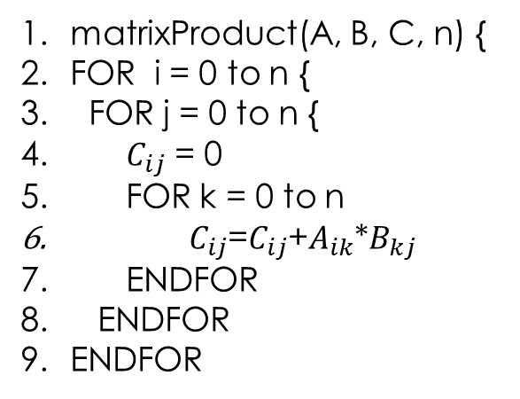
Algorithm 4 – multiplying matrices
matrixProduct(A, B, C, n) {
FOR i = 0 to n {
FOR j = 0 to n {
$C_{ij}$ = 0
FOR k = 0 to n
$C_{ij}$=$C_{ij}$+$A_{ik}$*$B_{kj}$
ENDFOR
ENDFOR
ENDFOR
i = 0
(i) row in A
i = 1
j = 0
(j) col in B
j = 1
A
B
k = 0
k = 1
0 1
2 3
4 5
6 7
C
(k)
movement
across the row in A
& down the column in B
0*4
2*4 + 3*6
+ 1*6
0*5
+ 1*7
2*5 + 3*7

Slide 46
Algorithm 4 – multiplying matrices
matrixProduct(A, B, C, n) {
FOR i = 0 to n {
FOR j = 0 to n {
$C_{ij}$ = 0
FOR k = 0 to n
$C_{ij}$=$C_{ij}$+$A_{ik}$*$B_{kj}$
ENDFOR
ENDFOR
ENDFOR
(i) row in A
(j) col in B
A
B
0 1 2
3 4 5
4 5
7
8 9
(k)
movement
across the row in A
& down the column in B
C
0*4 + 1*6 + 2*8 0*5 + 1*7 + 2*9
3*4 + 4*6 + 5*8 3*5 + 4*7 + 5*9

